Slide 1

Follow the Road to Revenue
The ROI Driven Sale
Optimize Sales Performance with an ROI-Focused Sales Process
This slide set drawn from the book ‘The ROI Driven Sale’ describes a logically structured, step-by-step method of:
Finding suspects
Converting them to leads
Nurturing them into opportunities
Closing the Sale
While the approach described in this slide set applies to large and complex sales, it contains universal concepts that are as valuable to small entrepreneurs as to major equipment or services suppliers.

Slide 2
PART 1 – Contents
PART 1
Get Your Market in Order
Develop Sales Momentum
Qualify the Opportunity
Build Trust and Offer New Ideas
Create the Value Proposition
Build the Winning Business Case
Close the Sale
In presentation mode, to return to this page from any other click on the logo

Slide 3
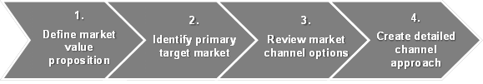
Get Your Market in Order
Marketing
Chapter 1
A Go-To-Market (GTM) best practice is to first precisely identify the target market and then determine the right channel to reach it effectively and efficiently. The key steps to create a GTM strategy are illustrated here:
We will discuss these in the next slides.

Slide 4
Analyze Target Markets and Develop Messaging
Marketing
Chapter 1
To get in the game, your message needs to resonate with challenges your target market faces. And don’t forget the web-based content!
So where do you begin?
List all potential customers for your product or service.
Determine best fit characteristics such as size of prospective business in terms of revenue or number of employees, type of business, and also consider geography.
Prioritize your market segments starting with those that are the best fit prospects
Messaging is the foundation for all marketing. An effective message strategy consists of a strong positioning statement – the central idea or theme for all marketing messages - and three to four support points addressing key target market problems. It starts by defining a compelling benefit – why the target market should care about your product, service, company or technology.

Slide 5
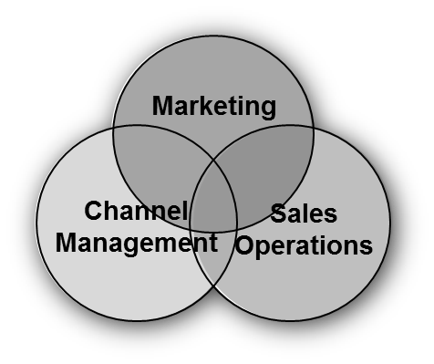
Establish the Distribution Channel Mix
Marketing
Chapter 1
Organize your channel strategy to create a WIN / WIN / WIN, for the customer, the channel, and you the vendor.
Effective channel management requires…
Alignment with product or service solution offered
Well-thought-out support model
Frequent, effective training
Constant communications
Fair treatment – like your own sales force
Regular evaluation of adequately detailed performance metrics

Slide 6
Create a Sales Playbook
Marketing
Chapter 1
Salespeople need ideas, facts, and figures at their fingertips to optimize their time with prospects. A well-thought-out playbook is a key tool to have in place.
Companies typically create a sales playbook to get salespeople to share and
consistently leverage best practices. The objective is to make the selling process easy to follow and to leverage proven strengths and minimize demonstrated weaknesses. What it ISN’T is a replacement for sales training.
An effective sales playbook offers key selling ideas covering a variety of customer, industry, and solution-related topics in an easy-to-use format.
The next page suggests what might be included.

Slide 7
What’s in a Sales Playbook?
Marketing
Chapter 1
A sales playbook might include:
A guide for what data to gather in the research stage
Messaging scripts by prospect type (role) which outlines prospect’s pain, solution capability and benefit to prospect - Email and phone
Thought leadership materials to build advisory relationship with executives
Qualification questions
Product features and data sheets
Materials which establish Company credentials
Customer case studies and success stories
Competitive info including how to compete strategies (understanding strengths and weaknesses)
How to overcome key objections
A financial metrics guide to help salespeople quantify (with prospect participation and buy-in) the potential impact of the solution (these are key for the ROI and business case development – see Chapter 4, ‘Determine the Impact’).

Slide 8
Generate Leads
Marketing
Chapter 1
Lead generation methods are rapidly evolving in cost and effectiveness. Choices are like an alphabet soup: advertising, web, mail, phone, events, webinars, workshops, Public Relations, media, social networking, customer references, telemarketing, trade shows, industry associations, leadership forums, product reviews, print, digital, enterprise content management, and speaking engagements. Topping the list are lead generating activities associated with the web and digital content.
Today’s buyers do their own research using search engines, social media, and other online channels, and can learn a great deal about a product or service before ever speaking to a sales person. They often decide whether to even consider a product based on the abundance of information readily available online. Reaching these ‘self-directed buyers’ requires new techniques to develop and qualify potential leads, starting with an effective digital presence.
Search Engine Optimization (SEO) tools are available from many sources including mainstream hosting sites.

Slide 9
Work the Web
Marketing
Chapter 1
A solid web-based lead generation strategy will help you build trust and capture the interest of your buyers before they are even ready to contact sales.
It doesn’t have to be expensive to be effective, but it does have to be good: a clear picture of how what you offer meets your prospects’ needs.
There are free and inexpensive tools available for building very slick looking sites, and skilled consultants who can build professional sites quickly – once you have a clear vision of what will generate leads.

Slide 10
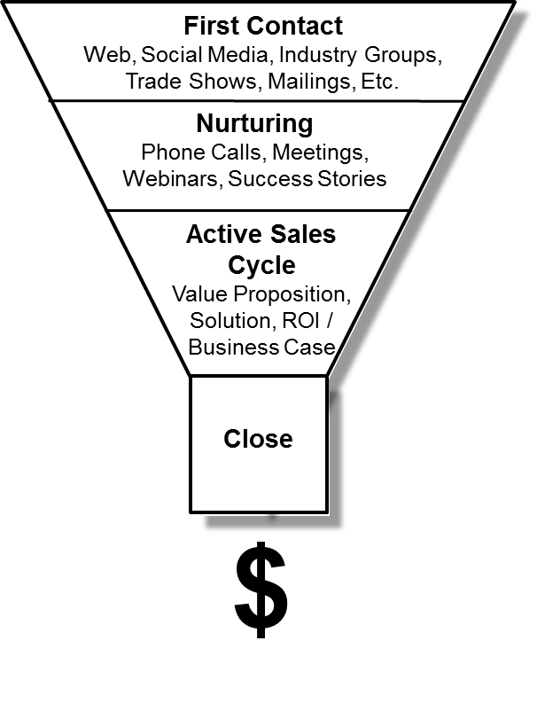
Manage the Sales Funnel
Marketing
Chapter 1
With the new type of buyer it is important to note that marketing efforts don’t end once a new lead comes into the system – known as
Top of the Funnel (TOFU) marketing.
Successful marketers invest in lead nurturing and other Middle of the Funnel (MOFU) techniques to build relationships and trust – earning the lead’s business once he or she is finally ready to buy. This holistic strategy focuses on getting the timing right and engaging leads with relevant content.
The best marketing programs have intentional measurement strategies planned in advance, answering these questions:
What will we measure?
When will we measure?
How will we measure?

Slide 11
Create Leadership Buzz
Marketing
Chapter 1
Individuals and businesses that can effectively communicate expertise as leaders and create “buzz” are well positioned to develop relationships as trusted advisors and build a loyal following for the business solution they offer.
Generally speaking, there are four characteristics most crucial to executive presence necessary to create leadership buzz: Demeanor – The right dress, hygiene, posture and demeanor convey a professional, executive image.
Communicate Insight – speak the business language important to your prospective customers and educate them with new ideas and perspectives, while connecting your ideas with their business strategy.
Personalize – connect with those you’re speaking to by adapting your style and developing rapport with them. Actively listen and be open to other points of view.
Results – work to develop a reputation as one who gets results, is a thought leader, and goes above and beyond to get the job done. Spark new thinking, and stir passion.

Slide 12
Convert Suspects to Leads
Marketing
Chapter 1
The impact of a ‘fit-first’ approach is enormous. In many organizations, 50% of sales energy is spent on prospects who never convert.
If you haven’t yet developed a lead management system, that is the best place to start. Collaboratively establish agreed-upon definitions of process steps leading to a ‘qualified lead’:
Know your ideal prospective customer ‘profile fit’
Define and agree on lead stages and lead terminology
Understand the difference between interest and intent
Give your leads a score and a grade
Stay top of mind with non-sales-ready leads, be visible
Create engaging, supporting content
Be viewed as a trusted advisor
at a company level
at a sales rep level
Create opportunities that generate revenue.

Slide 13
Manage the Content
Marketing
Chapter 1
Senior Management, Sales, Marketing, Services, Development, Operations, and Support all have areas of expertise to help develop content that will show your universe of target market prospects that you are the experts that can lead them to new ideas which will become competitive advantages for them.
Content will include case studies, success stories, presentations, blogs, webinars, trade show, industry events, speaking engagements, research reports, etc.
Having content is only part of the process. At least as important is getting it into the right hands. The marketing organization will be the main driver for the establishment, development and maintenance of the Content Management System (CMS). For most companies, this will be housed electronically in a digital repository that is an integral part of the company website. This CMS helps with content organization, management, delivery, and monitoring and analytics that become critical to the staged development of the sales funnel. It is also instrumental in on-boarding new employees and scaling the business with consistent messaging.

Slide 14
Leverage the Content
Marketing
Chapter 1
Becoming a trusted advisor as a company and as an individual sales person, with support from the Content Management System, has a significant impact on the ability to close sales.
The company becomes highly visible via its web presence, its reviews by analysts, its participation in industry groups as speakers and panelists and its constant flow of new content (case studies, success stories, etc.)
The individual sales person can also have a direct impact by:
Taking on activity in industry settings attended by prospective customers
Building questioning skills
Enlightening the prospective buyer with value propositions and an understanding of the financial aspects of the business

Slide 15
Turn Leads into Opportunities
Marketing
Chapter 1
To convert a lead to an opportunity requires close collaboration between marketers and salespeople. Before the hand-off, marketers need to ensure that the lead…
Has needs that your products and services fill
Has money
And ensure that your sales force…
Has every scrap of knowledge the marketing department has to offer about
The prospect and the prospect’s industry
The key contacts
Any history or current issues to resolve with the prospect
The suggested solutions to offer
Has the tools and training to follow the Seven-Step Sales Process to its conclusion, a profitable sale.

Slide 16
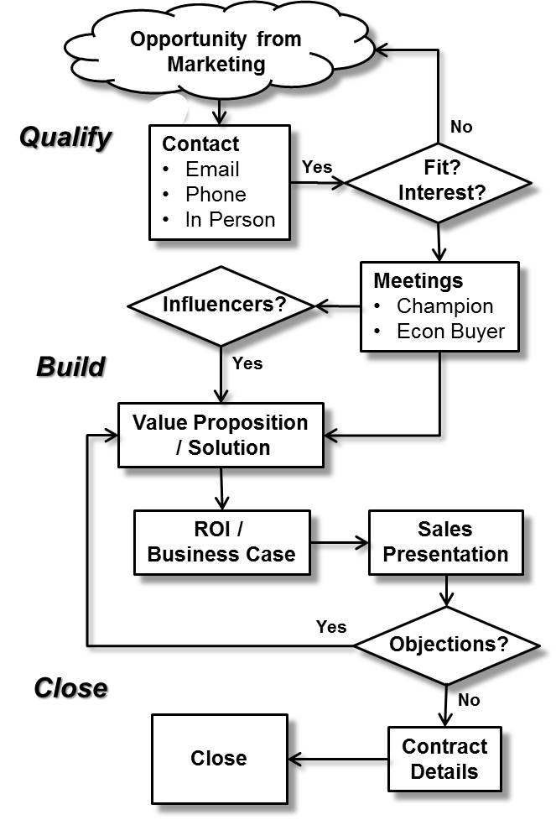
Develop Sales Momentum
QBC Process
Chapter 2
The guided process illustrated confirms interest and intent, builds advisory trust, connects the business dots and paints a picture of the new reality with a business case showing high impact monetized value and ROI yielding a timely call to action.

Slide 17
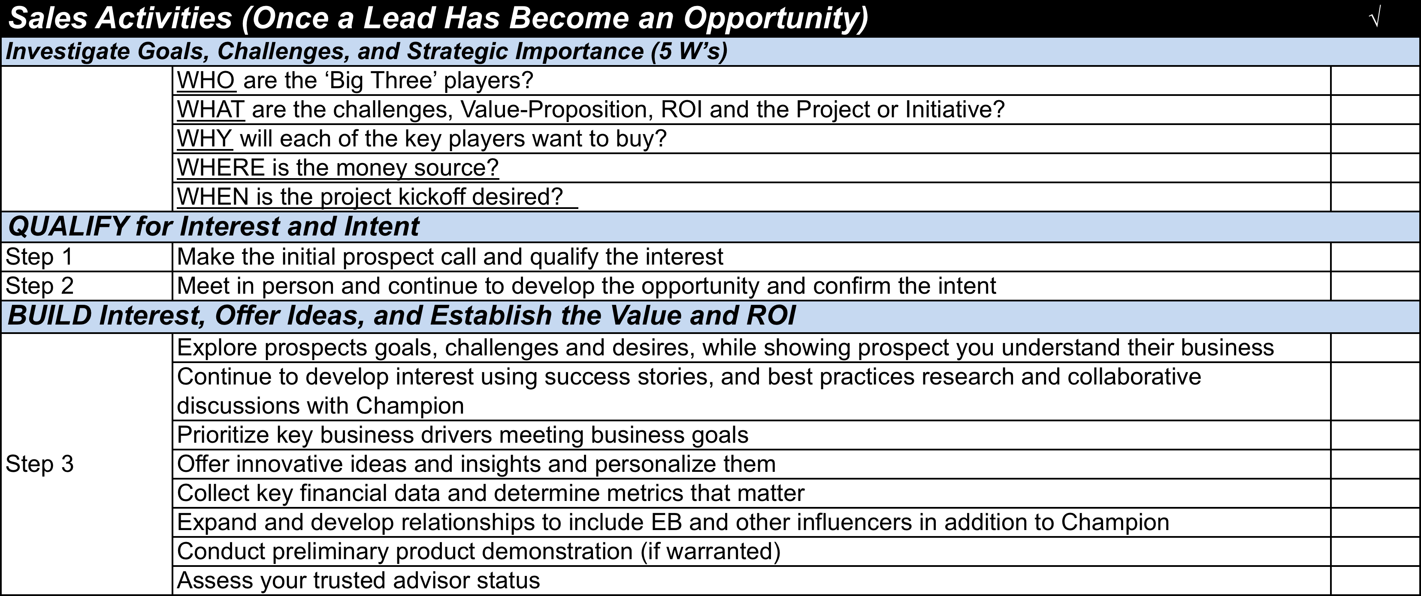
Use the Checklist
QBC Process
Chapter 2

Slide 18
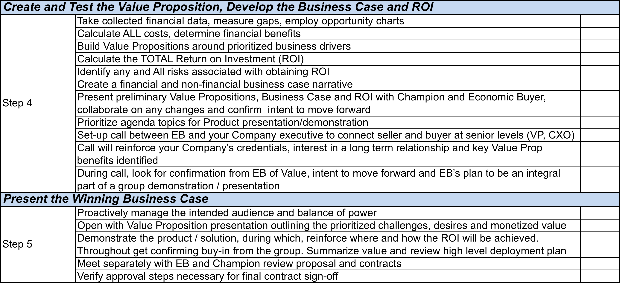
Use the Checklist (Cont’d)
QBC Process
Chapter 2

Slide 19
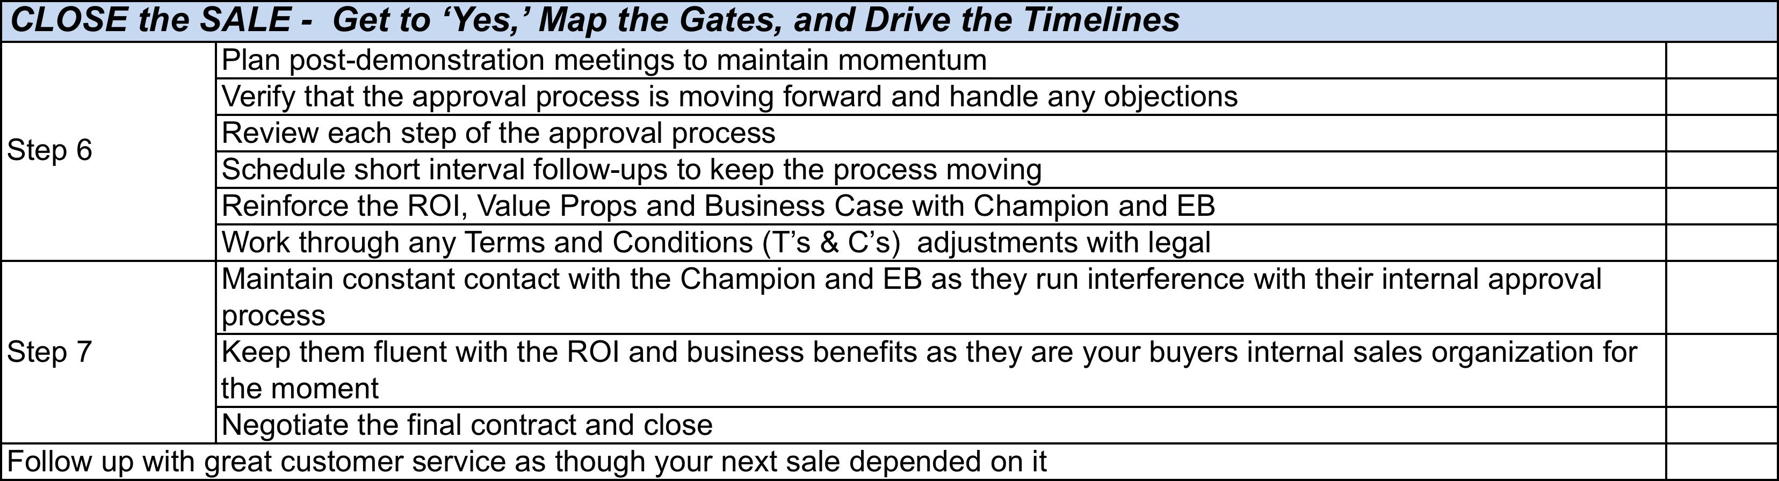
Use the Checklist (Cont’d)
QBC Process
Chapter 2

Slide 20
Investigate Goals, Challenges, and Strategic Importance
Qualify
Chapter 3
The seven step qualification process begins with a thorough understanding of the opportunity by researching, understanding and developing the ‘5 W’s’:
WHO are the ‘Big Three’ players:
Champion
Economic Buyer (EB)
Endorser/s
WHAT are:
The challenges (pain) / desires (gain)
The Value-Proposition
The Project or Initiative and its ROI?
WHY will each of the key players want to buy? Is the need or project important? How does it impact the business relative to revenue, expense, and /or market-position?
WHERE is the money source (corporate, division, budgeted, discretionary)?
WHEN is the project kickoff desired? What is the close timeline (identify milestones and gates)?

Slide 21
Investigate Goals, Challenges, and Strategic Importance (Cont’d)
Qualify
Chapter 3
Once you have deep background knowledge, you need to avoid getting stuck in unproductive thought patterns. Breakthroughs occur when you:
Challenge assumptions.
Reword the problem. Ask:
"Why do we need to solve the problem?"
"What's the roadblock here?"
"What will happen if we don't solve the problem?"
Reverse the thinking. Instead of focusing on how you could solve a problem, consider how you could create the problem.
Look for ideas in different media. visualization, anecdotes, webinars, etc.
Seek possible ideas from unexpected places. Ask questions such as:
“What are the functions needed to solve this problem, and what functional equivalents are available ANYWHERE?”
"What attributes of this item could help us solve our challenge?"
Get other perspectives. Collaborate with as many influencers as feasible.
Play the "what if" game. Ask yourself "What if I were ... How would I address this challenge?” Imagine yourself to be the CEO, for example.

Slide 22
Qualification Steps
Qualify
Chapter 3
Seven Step Qualification Process
Step 1:
Make the initial call (by phone or in person) to qualify the prospect with respect to the level of interest. The goal of this call is to confirm interest, develop further momentum, and set up next steps with key influencers and the Economic Buyer .
Step 2:
Meet in person and continue to develop the opportunity, with more specific insights into the prospect’s goals, challenges and readiness for further exploration. Continue to build the interest of the EB.
During the Qualification stage, strive to keep your meeting sizes small, ideally 1 to1. This will enable more rapport and relationship building opportunities with your Champion and other key players. Do not lose the Balance-of-Power by being dramatically out-numbered

Slide 23
Be a Credible Business Problem Solver and Trusted Advisor
Build Trust
Chapter 4
Your prospect cares more about the monetized business value (ROI) and the personal benefit (career enhancement, visibility, improved performance, etc.) your product / solution will provide than about its pure productivity or efficiency benefits. A trusted advisor:
Is genuinely interested in helping a prospective customer’s business
Works hard to understand a prospective customer’s business challenges
Is credible based on proven relevant previous customer successes
Connects with the prospect both constructively and emotionally by demonstrating keen business insights tied to the future upside and risks
Is reliable and consistent, as measured by speed and thoroughness in all follow-ups
Is authentic, while being passionate and enthusiastic about solution advice
Treats the business relationship as if it will be long term
Recognizes that building trust takes time and requires dedicated work

Slide 24
Trusted Advisor Requirements
Build Trust
Chapter 4
To become a trusted advisor, you must:
Be an active listener
Establish credibility through ability to offer new and innovative ideas
Be highly reliable – quick to respond and thorough
Balance asking questions with giving advice
Collaborate with prospective customer with long term view
Offer new ideas
Demonstrate that you are investing your time in their success.

Slide 25
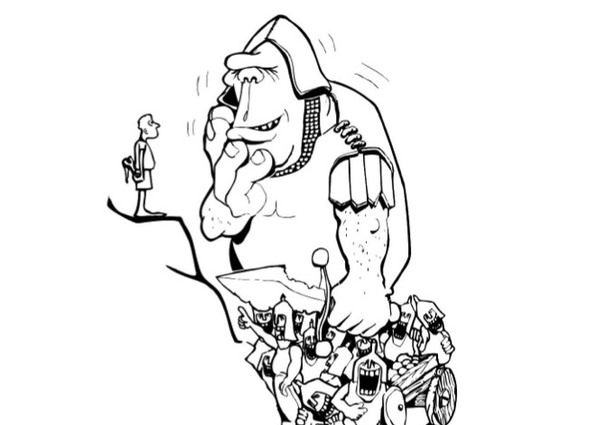
Demonstrate the Value of Your Solution
Value Proposition
Chapter 5
It is easy to get the attention of your prospects if the solutions you offer provide huge, impactful benefits for problems looming large on their radar. It behooves you to learn as early as possible just how important your solution will be.

Slide 26
Determine the Value Proposition
Value Proposition
Chapter 5
Seven Step Qualification Process
Step 3:
Survey prospects to understand the customer requirements in order to define the value proposition. This step often provides opportunities to introduce new ideas and educate the prospect about new solutions and evolving cost-benefit considerations.
The Champion prioritizes the drivers yielding largest business benefit
Interviews and surveys are conducted with all key influencers to confirm current processes and quantify impact with new solution
Further probing of business requirements takes place to ensure all potential needs are identified and mapped to solution capabilities, driving value propositions and projected monetized value
Gain enough input to prioritize the product demonstration
Financial information collected to formalize Value Proposition Document and Return on Investment Document

Slide 27
Build the Winning Business Case
Business Case
Chapter 6
A Business Case estimates the impact – especially financial – supporting any investment, such as equipment or software installations, business acquisitions, focused Six Sigma projects, broad Lean Production Culture projects, or any other initiatives aimed at improving business results. Improvements are likely to impact your prospects’ finances in one of four positive ways:
Increased revenue
Decreased Cost of Goods Sold
Decreased corporate overhead
Decreased asset requirements (with associated period expenses such as depreciation and carrying costs)
These benefits will be offset by investments in:
Added corporate overhead spending (on people who do the work, for instance)
Added assets (machinery, equipment, software and the like) with associated period expenses such as depreciation and carrying costs)

Slide 28
Prepare the Buyer for the Sales Presentation
Value Proposition
Chapter 5
Seven Step Qualification Process
Step 4:
Pre-present the solution and business case to the Champion and, when he / she is on board, to the Economic Buyer. NEVER go into a final sales presentation without knowing exactly where each key decision-maker stands
Set up a call between the EB and your company executive to connect seller and buyer at senior levels
Your company executive…
Reinforces your company’s credentials and interest in a long term relationship with the EB’s company
Re-states at a high level the key value proposition benefits
Looks for confirmation from the EB of the intent to move forward
Ensures there are no surprises in store
You or your company executive invite and encourage the EB to be an integral part of the final presentation and ask for time afterward to review any questions

Slide 29
Determine the Metrics that Matter
Business Case
Chapter 6
Find out what your prospect values most and focus on accurately measuring the current state to develop a credible baseline.
Follow these steps:
Review the metrics the prospect uses
Review year-on-year performance
Review industry benchmarks for cost ratios (per cent of revenue by category)
Develop new ratios that link your solution to prospect performance (see the Chapters on Metrics and Financial Literacy in the book for ideas)

Slide 30
Measure the Gaps
Business Case
Chapter 6
The term ‘gap’ here refers to the amount of underperformance your prospect is experiencing on any metric that matters.
Follow these steps:
Collect and review P&Ls and Balance Sheets to understand the landscape
Focus especially on areas where your proposed solutions will help
Get prospect’s view of trends and future prospects with ‘business as usual’
Using the metrics baseline you gathered, estimate the gaps – how much improvement is needed in revenue or cost drivers
Use the ‘Gap’ tool on the available CD to suggest improvement targets

Slide 31
Define the Solution and Deployment Plan
Business Case
Chapter 6
To close a sale, your solution will have to be compelling in its scope and logic, without any significant errors. Your prospect will be relentless in asking:
Exactly WHAT are you going to deliver and do?
Exactly HOW does this affect the gaps we have agreed?
Exactly WHEN will we see measurable results?
Exactly WHEN will the financial results appear?
The business case must be closely linked to the solution plan and as intuitive as possible, with accurate math and a clear schedule.

Slide 32
Employ Opportunity Charts
Business Case
Chapter 6
You can’t start improving anything until people agree It is broken, fixable, and worth it. Therefore, as the sales team investigates an opportunity, it is important to organize information to keep solution plans aligned with expected results.
Use a format such as the example shown on the next page (a printable blank version appears on the page following the example)
Continuously apply financial analysis to each chart, asking
Accurate data?
Sound logic?
Solid documentation?
Link the business case directly to the charts to ensure understanding and agreement

Slide 33
Typical Opportunity Chart
Business Case
Chapter 6

Slide 35
Calculate the Financial Benefits
Business Case
Chapter 6
The first question to ask of any project is, “what will the benefits be?” Benefits can fall into many categories, such as increased customer or employee satisfaction, productivity gains, and financial performance improvement. Here we are primarily focused on the financial impacts, and on how your offering promises to return more than it costs.
Financial benefits may include:
New or enhanced revenue
Lower cost of goods (labor, material, or factory efficiency improvements)
Lower corporate overhead
Better asset utilization (for example, improved inventory turns) providing one-time balance sheet improvements.

Slide 36
Calculate ALL the Costs
Business Case
Chapter 6
In an effort to ensure complete buy-in to your ROI estimates, provide as accurate and complete an analysis of costs as you do of benefits. This honest approach is critical to your credibility as a trusted advisor.
With business products, services, and solutions, costs might include such elements as:
The time of people whose work will need to be done by others
Costs of internal and external experts / consultants
Any equipment required to install or use the solution

Slide 37
Calculate the TOTAL Return on Investment
Business Case
Chapter 6
The sales team creates the business case for only one purpose, to show the value and ROI that make the purchase decision compelling for the solution. It is useful to use a flexible tool with commonly accepted financial information in order to answer sales team and buyer ‘what if?’ questions quickly and accurately. The next pages illustrate the type of information that business people expect.

Slide 38
Identify Any and All Risks
Business Case
Chapter 6
Nothing ever works precisely as expected. You need to help your buyer gain confidence in the solution you offer by identifying the risks and the means of mitigating them. Consider:
Will the INVESTMENT be as advertised?
Will the SCHEDULE be as expected?
Will it work EXACTLY as advertised?
Will the BENEFITS be as expected?
There are often specific and predictable possibilities to be considered, calling for scenario planning to estimate their impact on your solution. Such sensitivity tests help to visualize what might happen if an investment under or over performs, and to develop contingency plans.

Slide 39
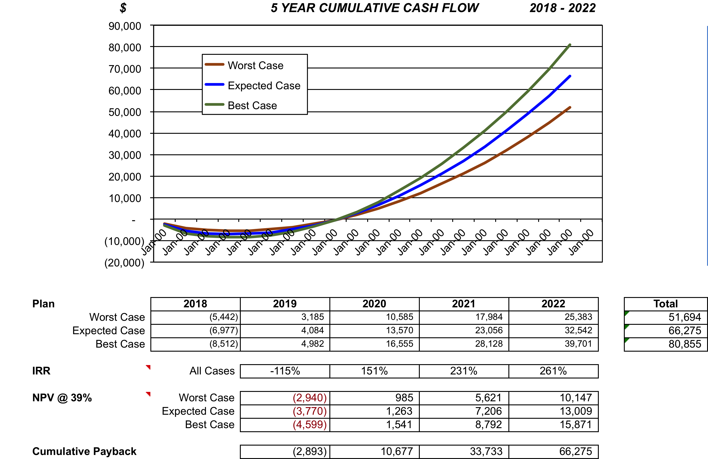
Payback
Business Case
Chapter 6
Answer three key questions with a powerful visual display:
How deep is the deepest investment?
When will we get our investment back?
How much will we make over the planned period?

Slide 40
Standard ROI Computations
Business Case
Chapter 6
Is this a good investment? Show the Net Present Value (NPV), the Internal Rate of Return (IRR), and the expected annual results. And for credibility show the upside and downside, too.

Slide 41
Create a Financial and non-Financial Narrative
Business Case
Chapter 6
The deal win strategy is not just about affordable cost, but a financial business case showing substantial ROI while meeting the prospective customer’s business needs (challenges and desires). Together, this compelling approach gets senior management attention and dramatically improves the probability of closing a sale.
Your narrative – the structure and content of your sales presentation – will take on a life of its own in your buyer’s organization, so it must clearly explain:
How your solution will help the buyer’s company financially
How your solution will make life
easier for the buyers and their organizations
How your solution will enhance your buyers’ careers / personal wins
How your solution will improve business operations in line with the buyer’s vision, with minimal organizational disruption

Slide 42
Demonstrate the Value of Your Solution
Value Proposition
Chapter 5
Seven Step Qualification Process
Step 5:
In a confirmation meeting with the EB in attendance, demonstrate the product, verify how the ROI will be achieved, and outline the proposal.
Confirm that the EB will provide post presentation review time
Open with the value proposition presentation
Demonstrate the product laced with anecdotes from the prospective customer organization
Throughout the course of the demonstration get confirming buy-in
NOTE: Resistance must be dealt with accurately and respectfully. STOP the demonstration and RESCHEDULE if key decision makers are not in agreement with the solution.
At the conclusion meet with the EB and confirm buy-in of the team and plan next steps. If ready, provide a first draft of the proposed contract.

Slide 43
Get to ‘Yes,’ Map the Gates, and Drive the Timelines
Close the Sale
Chapter 7
Closing a sale is more than gaining commitment. For many organizations, before a PO is initiated and a contract is signed, there can be a multi-step process comprised of business case reviews and multiple sign-offs. Know the process and timing, so you can be proactive in assisting with gates that may get closed on the deal. This will increase your ability to get the contract signed and will improve your forecast accuracy.

Slide 44
Plan Post Demonstration Meetings
Value Proposition
Chapter 5
Seven Step Qualification Process
Step 6:
Plan post-demonstration meetings and have documents ready in draft form. Activities include:
Verify customer’s intent to move forward and handle objections
Review each step of the approval process leading to a signed contract. Get deep into the process so you know the who and when of each of the approval gates, legal review steps, and procurement steps
Schedule short interval follow-ups to keep the process moving, and to know where it stands at all times.
Reinforce the ROI and value proposition with your Champion and EB, so they become fluent with it and are able to overcome any internal objections.
Every delay in getting this approved is delaying the realization of the benefits.

Slide 45
Plan Post Demonstration Meetings
Value Proposition
Chapter 5
Seven Step Qualification Process
Step 7:
Negotiate the final contract and close.
Activities include:
Maintain constant contact with the Champion and the EB as they run interference with the internal approval process
Keep them fluent with the ROI, value propositions and business benefits so they can use that for their own internal business case. You want them to be able to take on your role internally and they should be fully bought into doing that at this point.
Identify and manage any risks to overcome (such as legal Terms and Conditions) proactively.
Obtain the signed contract.
Immediately plan, or begin, the post-contract deployment process.

Slide 46
Follow Up
Close the Sale
Chapter 7
There is nothing as good for your marketing and sales efforts as a satisfied customer – and nothing worse than an angry one.
With complex sales, tossing a contract over the wall to the delivery team is worse even than catching an undeveloped lead from the marketing team, because your company’s reputation depends on the consistent quality of EVERY customer experience.
Most vendors have a formal internal handoff process to ensure what has been sold is clearly understood by the delivery organization. If yours does not, it is well worth considering how you will ensure that what you have promised will be delivered.

